Slide 1

Computer Solution Technology
Rajesh Rajchal
MSSE 663 Web Frameworks
Course Prof. Jelena Vucetic
Regis University

Slide 2
Features
Users
View All products
View specific products
Purchase
Manager
All users can do CRUD features

Slide 3
Architecture
Initially planned: MVC
More like Client – Server Architecture
Client: Front End – All front pages or Views
Server: Back End – Model and Controllers
Client
Server

Slide 4
Web Contents
Product
User
(Admin and Non-Admin)
Payment

Slide 5
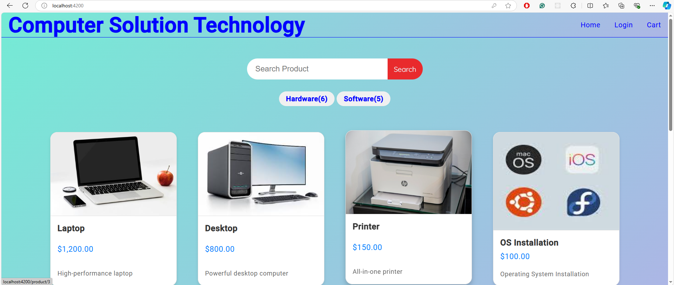

Slide 6
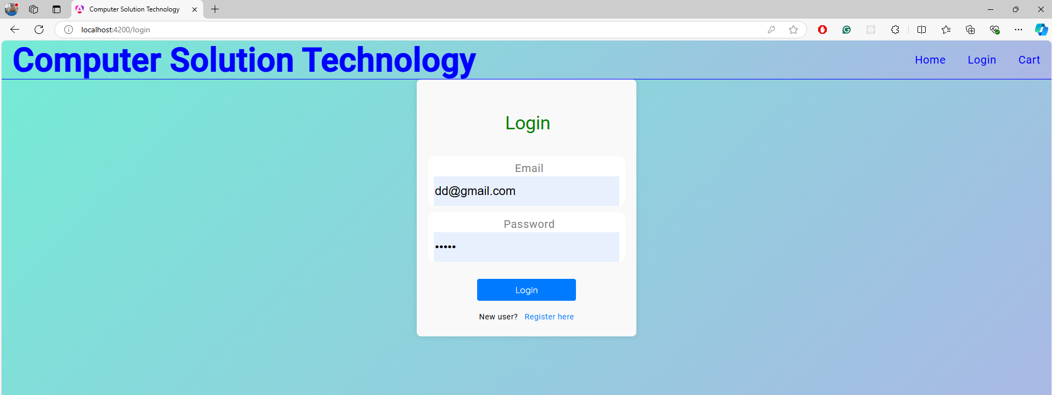
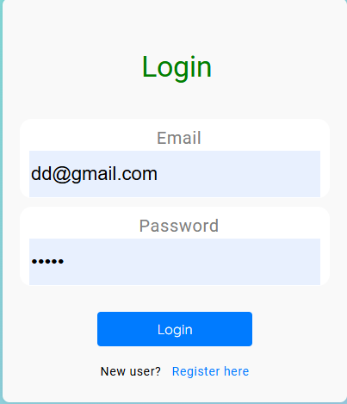

Slide 7
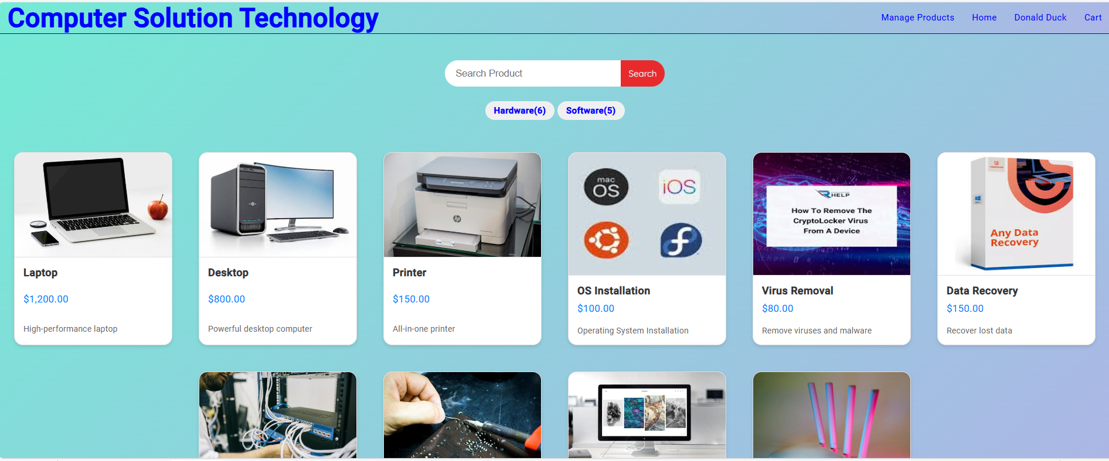

Slide 8
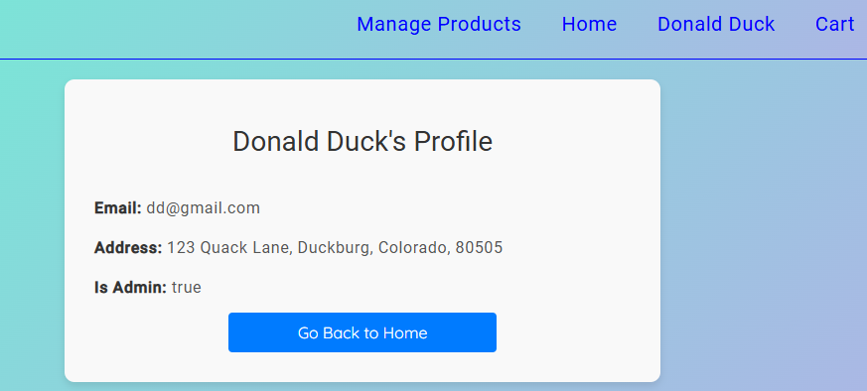
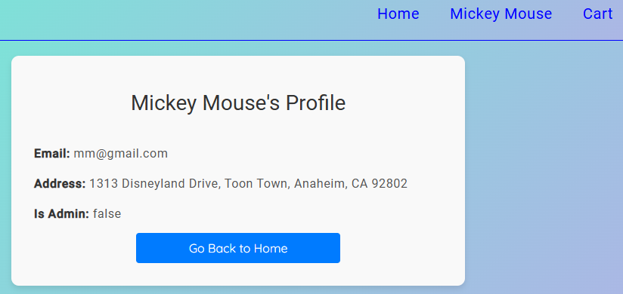
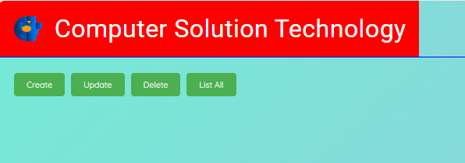
Admin Privileges: A Comparative View

Slide 9
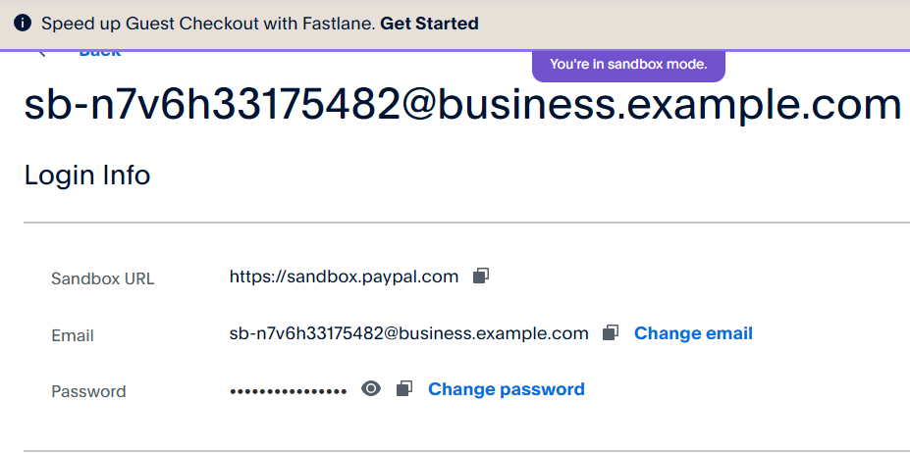
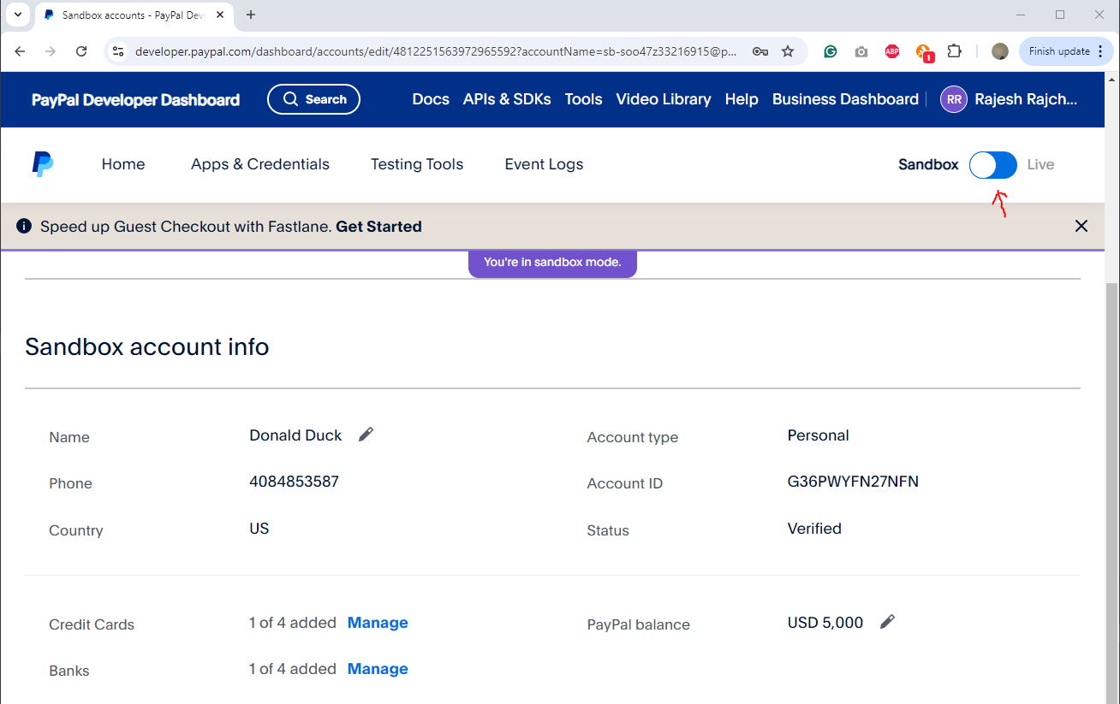
PayPal Sandbox Account

Slide 10
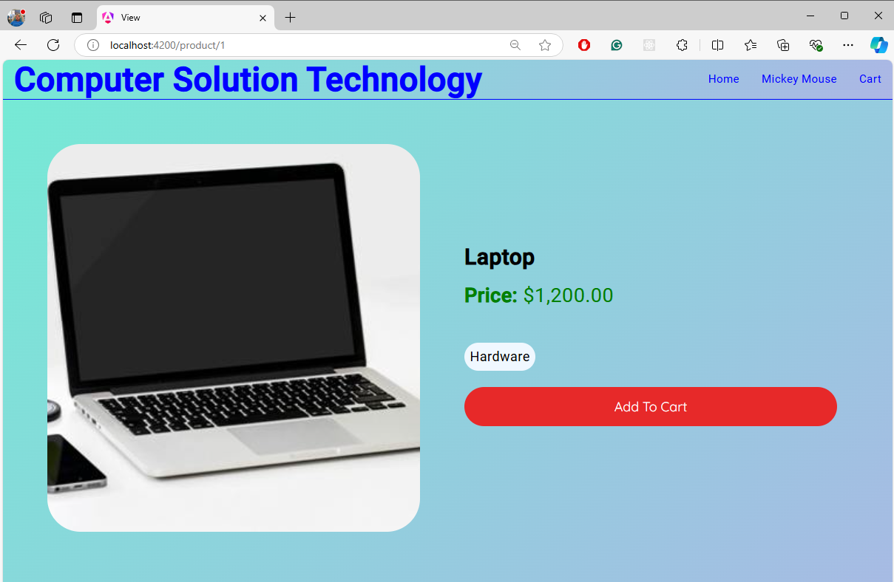
Add to Cart

Slide 11
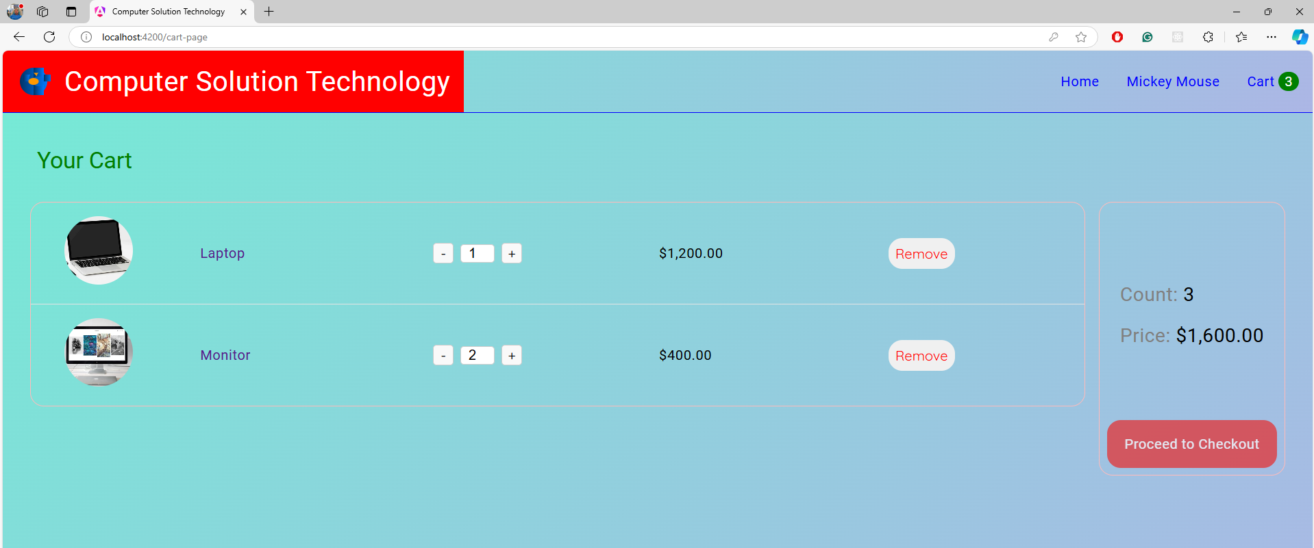
Add to Cart

Slide 12
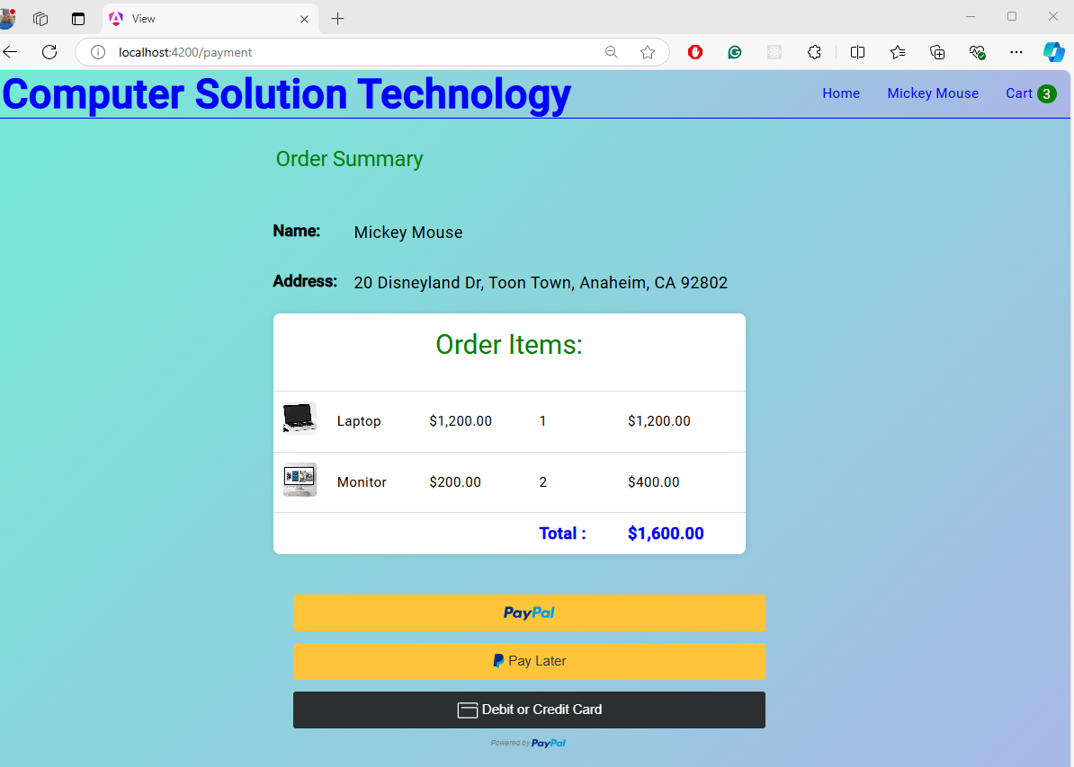
Payment

Slide 13
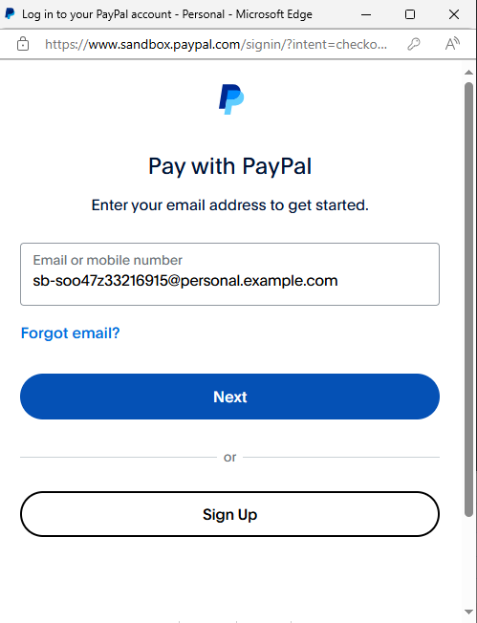
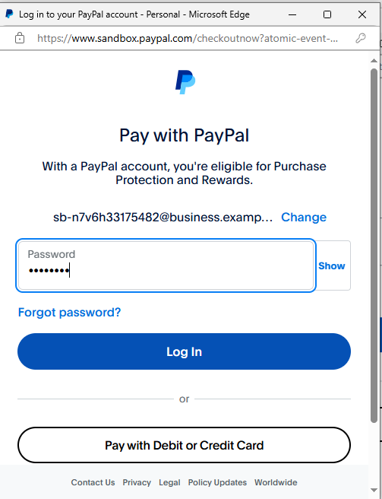

Slide 14
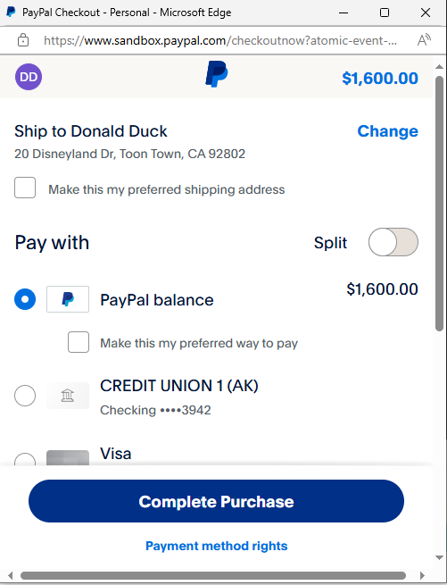
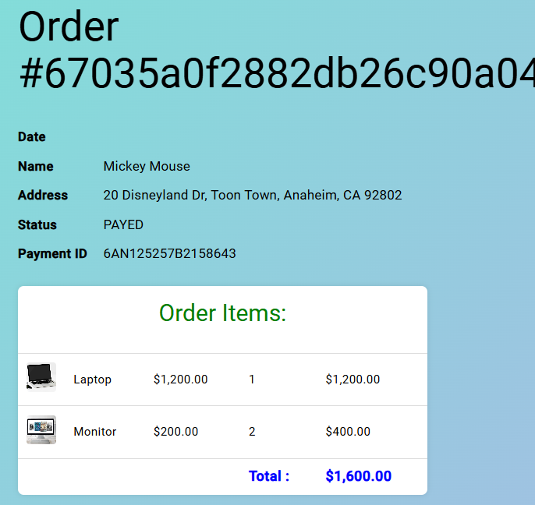

Slide 15
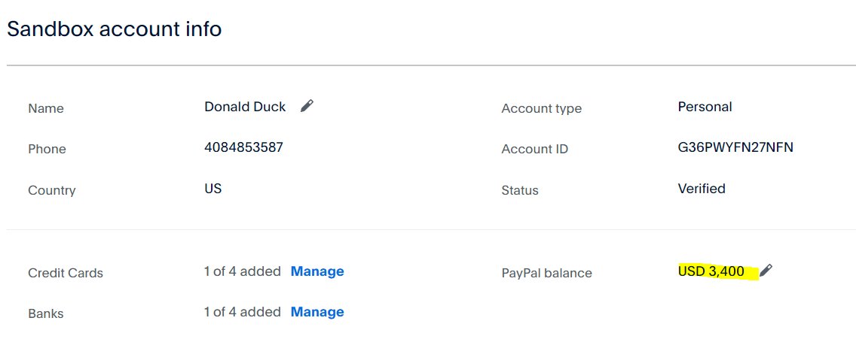
5000-1600=3400

Slide 16
Feature: Accessibility
High Contrast Mode: Provides a high contrast mode to assist users with visual impairments in distinguishing between different items.
Simplified Navigation: A clear and straightforward navigation system to help users with cognitive disabilities find the services they need.
Screen Reader Compactivity: Dynamically change the view for smaller or bigger screens.

Slide 17

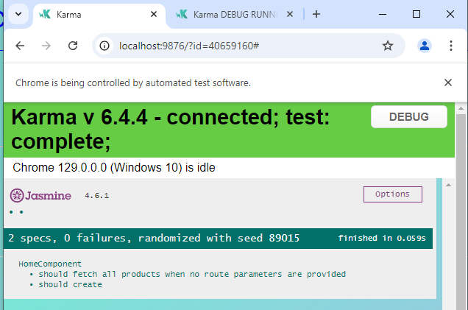
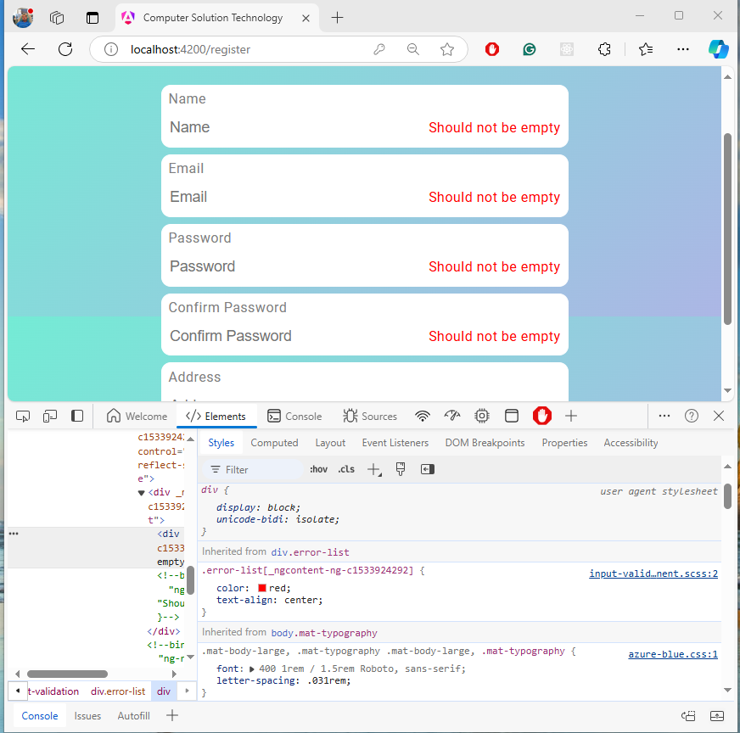
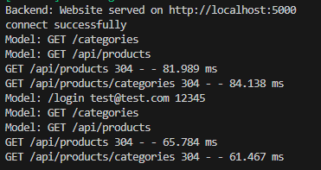
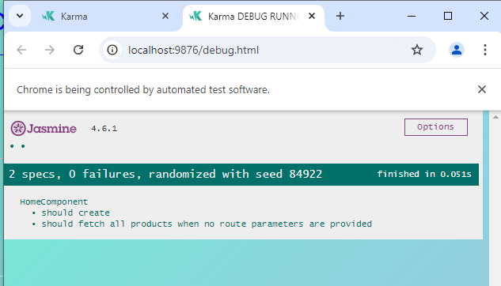
Testing
API Testing
Unit Testing
Extremely helpful in API testing, especially, Create, Read, Update, Delete
Orders
Also, helpful in checking Products, Debug
Console

Slide 18
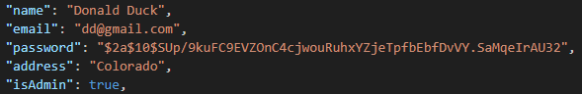
Security
Encrypting Password:
const encryptedPassword = await bcrypt.hash(password, 10);
Authentication with Username and Password
Authenticating with Guard: Validates user’s access
ng g guard auth
Add authentication Token: Attach authentication tokens and credential
ng g interceptor auth
12345
Notes:
ng g guard auth: When a user tries to navigate to a specific route, the guard’s canActivate method kicks in. Inside canActivate has a logic. Based on the logic, the user is either allowed or block
ng g interceptor auth: It protects routes and handles responses via tokens and credential

Slide 19
Lesson learned: Problems and Prospects
Work on Software Design first
Develop Test Procedure
Plan with Architecture Design
Plan the UX

Slide 20
Resources
This class – Articles
https://foodmine-new.herokuapp.com
ChatGPT: SCSS, Compilation Errors, especially imports
YouTube: https://www.youtube.com/watch?v=N_UQx8dPPkc&list=PLW2eQOsUPlWJRfWGOi9gZdc3rE4Fke0Wv&index=1
https://www.youtube.com/watch?v=iNMICDE2e6E&t=2080s
https://www.youtube.com/watch?v=iNMICDE2e6E&t=2087s

Slide 21
Thank You

Slide 22
Extra slides
The following slides are just for back up purposes

Slide 23
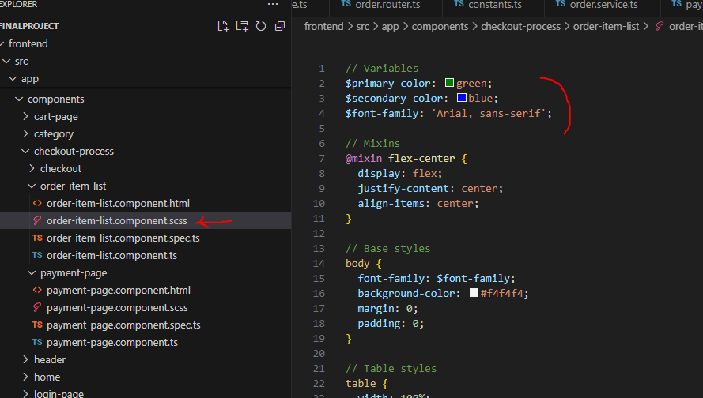
scss: Sassy Cascading Style Sheets

